Slide 1

PLANNING IN AI
PLANNING GRAPH
Ankeeta Mitra
23.06.25

Slide 2

Glossary
Proposition (or Fact): statement that can be true or false.
Predicate: A function or relation applied to one or more variables or constants. It represents a condition or property that can be true or false (e.g., Function(x, y), Holding(x)).
Literal: A specific assertion about the world. They are actual elements used in explaining states and goals.
e.g., At(Robot, RoomA) is a positive literal, and ¬Has(Key) is a negative literal.
Ground Atom: A predicate where all variables are instantiated with constants (e.g., At(R1, RoomA)).
Action Schema: A general action with parameters (e.g., Move(?r, ?from, ?to)) used to generate specific (grounded) actions.

Slide 3
Glossary
State A specific configuration of the world, represented by a set of true facts (literals).
E.g.: At(Robot, RoomA) ∧ Has(Robot, Key)
Action An operation with preconditions (what must be true to apply it) and effects (what it changes in the world).
E.g.: Move(Robot, RoomA, RoomB)
Goal A desired condition or set of conditions the agent is trying to achieve.
E.g.: At(Robot, RoomB) ∧ Has(Robot, Key)
Agent
An agent is defined as anything that can be viewed as perceiving its environment through sensors and acting upon that environment through actuators

Slide 4

INTRODUCTION
What is planning?
Planning in Artificial Intelligence refers to the process of selecting and organizing a sequence of actions to achieve specific goals.
An agent must analyze the current state, anticipate the effects of actions, and decide which actions will move it toward the desired goal.
For example, in robotics, planning might involve navigating a room with obstacles or interacting with objects to complete a task. Planning is a fundamental capability for any autonomous intelligent system.

Slide 5

BRIEF Background
Classical planning
Classical planning is a branch of AI planning that operates under certain idealized assumptions:
the world is fully observable
actions are deterministic
Static environment
A classical planning problem is typically defined by an initial state, a set of available actions (each with preconditions and effects), and one or more goal conditions.
This framework is highly structured and well-suited for developing foundational planning algorithms.

Slide 6
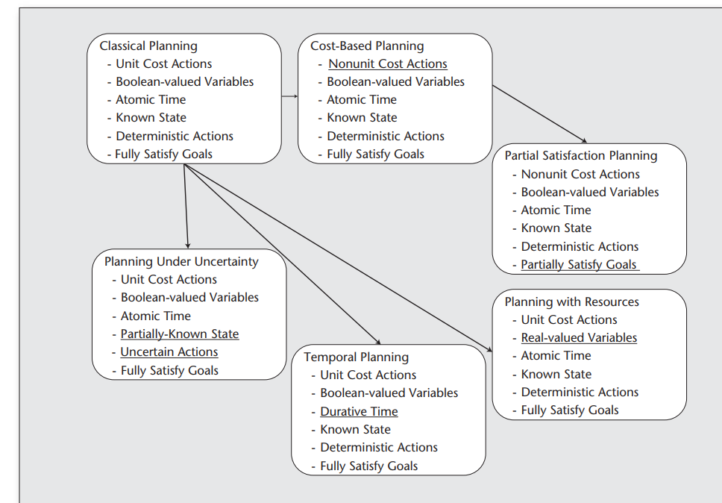
Taxonomy OF PLANNING MODELS
A Tutorial on Planning Graph Based Reachability Heuristics - Daniel Bryce and Subbarao Kambhampati

Slide 7
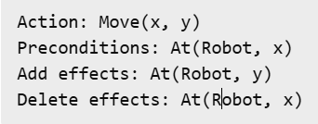
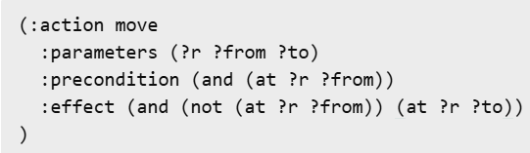
STRIPS
PDDL
PDDL (Planning Domain Definition Language)
It generalizes STRIPS and adds support for typing, numeric fluents, and temporal elements.
Problem file defines the initial state and goal.
Domain file defines actions, predicates, and types.
STRIPS (Stanford Research Institute Problem Solver) is a formalism used in classical planning
Formalism to represent actions.
Action = Preconditions, Add list, Delete list
Two of the most common formal systems for defining: STRIPS and PDDL. STRIPS was the original system, and PDDL is the modern, extended standard based on STRIPS.
Notes:
Typing allows objects to be categorized (e.g., Robot, Location), enabling safer and more efficient planning by limiting applicable actions to correct types.
Numeric fluents are numerical variables that can be increased, decreased, or compared (e.g., battery level, fuel, distance).
Temporal elements allow planners to handle action durations, time windows, and concurrency—enabling plans that include timed or overlapping actions. For example, an action can take 5 seconds, or two actions can run in parallel if they don't interfere.

Slide 8
COMPLEXITY TERMS
P (Polynomial Time): Efficient, fast.
NP (Nondeterministic Polynomial Time): problems that can be solved in polynomial time by a nondeterministic machine and can be verified in polynomial time by a deterministic machine.
PSPACE: Problems solvable using limited memory, may take exponential time.
PSPACE-complete: The hardest problems in PSPACE.

Slide 9
Why is planning HARD?
Planning = searching for a path through possible states.
Each action changes the state (Eg: Clear(C) is fact, can be true or false in a state)
The problem:
Let’s say the planning problem involves N different facts.
Since each fact can be either true or false, the total number of possible states of the world is:
2 × 2 × 2 × … × 2 = 2^N
This means that for N facts, there are 2^N possible combinations of truth values across all those facts.
The plan could be exponentially long.
This places the problem in PSPACE.

Slide 10
Why is planning HARD?
On(A, B) | Clear(B) | Holding(C)
T | T | T
T | T | F
T | F | T
T | F | F
F | T | T
F | T | F
F | F | T
F | F | F
There are 2^3 = 8 combinations of true/false across 3 facts.
Each combination = a different world state.
Even if actions are small and simple (say, 2 preconditions and 2 effects), they still are changing states in this massive space.

Slide 11
Why is planning HARD?
Actions Can Reuse, Revisit, or Undo Progress
If actions can delete facts:
A fact that was true can become false again.
It is possible to revisit the same world state multiple times.
It is a must to account for cycles, backtracking, and dead ends.
So, progress isn’t guaranteed!
There is a need to explore and backtrack many paths, they could be long and looping in nature just to find a valid one.

Slide 12
Why is planning HARD?
PLANS can be exponentially long
Facts interfere and may be interconnected based on dependencies with one another (called subgoal interactions),
There is a need to achieve them in a careful order,
But the right order isn’t obvious or direct.

Slide 13
Why is planning HARD?
No need of Exponential Memory!
Even if the plan is long, we can explore the search:
One path at a time,
Using only a stack of current decisions and the current state,
Reusing space as we backtrack.
This is exactly what a PSPACE algorithm does:
Explores a huge search space,
Uses limited memory,
May take exponential time, but bounded space.

Slide 14
Why is planning HARD?
Planning is PSPACE-complete
The search space is huge,
Dependencies and deletions make paths non-monotonic,
Exploration can be done with polynomial memory, but requires checking many paths.

Slide 15
Why is planning HARD?
Negative Effects Make Things Harder
If we allow delete effects (negative postconditions):
Actions can undo previous actions.
State space becomes non-monotonic (can go forward and back).
Need to reason about all paths, including ones with loops.
This looping + backtracking makes it the problem PSPACE-complete

Slide 16
Why is planning HARD?
Negative Effects Make Things Harder
If we allow delete effects (negative postconditions):
Actions can undo previous actions.
State space becomes non-monotonic (can go forward and back).
Need to reason about all paths, including ones with loops.
This looping + backtracking makes it the problem PSPACE-complete

Slide 17
Why is planning HARD?
Reducing to Polynomial Space
Only positive effects (no deletes)
At most one effect per action
One goal or constant number of goals
No need to "undo" previous actions
Then:
Planning becomes monotonic, i.e. once a fact is true, it stays true.
We can greedily build up the goal.
State space shrinks, so solvable in polynomial time.

Slide 18
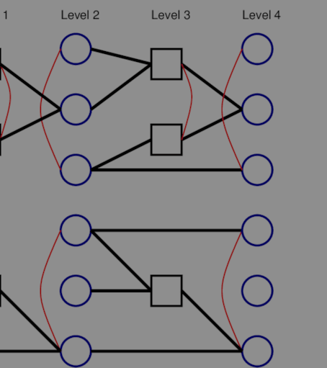
Classical Planning Approaches
State-Space Search explores the space of world states directly, moving forward from the initial state or backward from the goal. e.g., (Progression, Regression)
Plan-Space Search focuses on constructing a partial plan and refining it until all constraints are met. e.g., Before(action_A, action_B)
PLANNING GRAPH
Represents the evolution of actions and states over time using a layered graph structure. They provide a compact overview of which actions and facts are possible at each step.
Notes:
Forward Search (Progression): Starts from the initial state and applies actions until the goal is reached.
Backward Search (Regression): Starts from the goal and regresses through actions to find a matching initial state.
a set of actions along with a set of constraints that specify the order in which some actions must occur (e.g., Before(action_A, action_B))
procedure-
begins with an "empty plan,
2. The planning procedure then iteratively identifies a "flaw" in the current partial plan. A flaw is any aspect that prevents the partial plan from being a complete and valid solution (e.g., a precondition for an action in the plan is not met, or a goal is not achieved)
3. To correct a flaw, the algorithm makes an "addition" to the plan, such as inserting a new action or adding an ordering constraint. If a flaw cannot be corrected, the search "backtracks"

Slide 19
LIMITATIONS OF CLASSICAL Planning
The number of possible states can grow exponentially, a phenomenon known as state explosion. This happens because for each fact or condition in the environment, there may be two possibilities—true or false—and with N such conditions, the number of possible world states becomes 2^N.
Moreover, when multiple agents or objects interact through different combinations of actions, the branching factor increases rapidly, making the total number of reachable states grow exponentially.
Without good heuristics, search algorithms can waste time exploring irrelevant paths.
There is redundancy in recomputing similar or overlapping action sequences. To overcome these issues, a more structured and efficient representation is needed—this is where planning graphs come in.

Slide 20
WHAT IS A PLANNING GRAPH?
A planning graph is a data structure that provides a compact representation of how actions and states evolve over time.
It alternates between layers of state levels (Si), representing facts that might be true, and action levels (Ai), representing actions that could occur given the preceding state.
This structure supports efficient reasoning about what is achievable, when, and under what constraints.
The planning graph grows outward from the initial state until the goal becomes reachable without conflict.

Slide 21
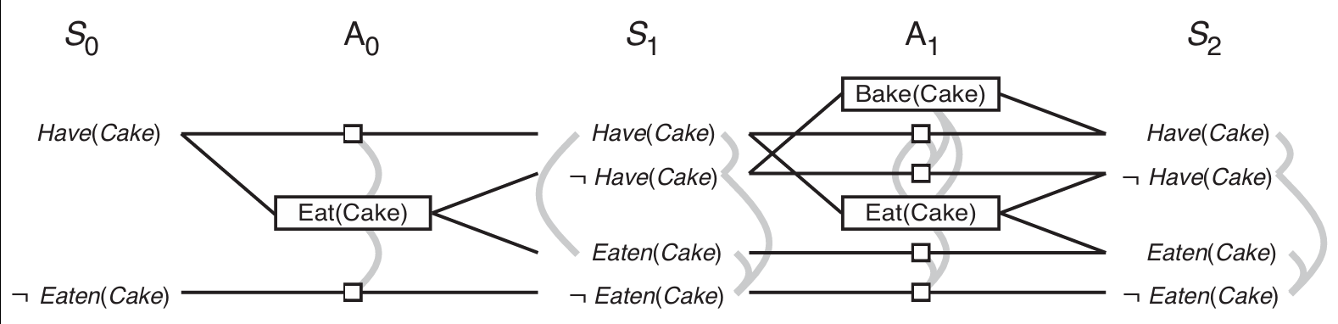
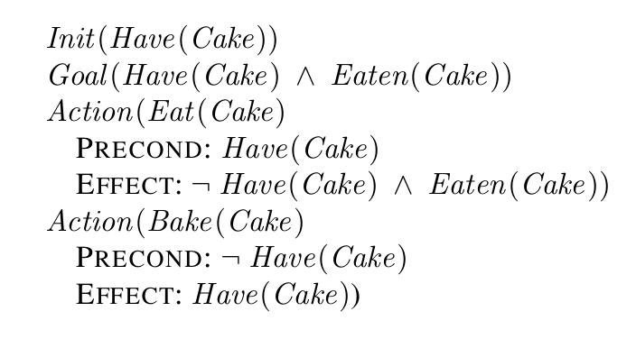
Action mutex examples: actions that have conflicting effects, interfere with each other's preconditions, or require mutually exclusive conditions.
Literal mutex examples: facts that are negations of each other or can only be supported by mutually exclusive actions. Tracking mutex relationships is critical for determining whether a set of goals is simultaneously a

Slide 22
Sequencing problem
There could be several goals!
E.g.: Goal is to both have a cake and have eaten it.
Eat(Cake): consumes the cake (deletes Have(Cake), adds Eaten(Cake))
Bake(Cake): creates a new cake (adds Have(Cake))
Initially, having and eating the cake are mutually exclusive because eating removes the cake.
However, if we include the action to bake a cake after eating it, both goals can be satisfied, though not at the same time. This illustrates how planning graphs help us resolve such sequencing conflicts.
The key is to have a sequence and have a comparatively best sequence at that! - HEURISTICS

Slide 23
Heuristics
What is a heuristic in planning?
A heuristic (denoted as heuristic function h(s)) is the cost or distance from a given state s to the goal state in a planning problem.
It helps the planner prioritize which states to explore first.
What is an admissible heuristic?
A heuristic function h(n) is called admissible if it never overestimates the true cost of reaching the goal from node n.
Let:
h(n) = heuristic estimate of cost from node n to the goal.
h*(n) = actual minimum cost to reach the goal from n.
Then:
Admissible ∀n, h(n) ≤ h*(n)
This ensures that the heuristic always gives a lower bound on the real cost, possibly optimistic, but never overly optimistic.

Slide 24
BLOCKS WORLD PROBLEM
The block world problem is one of the most famous planning domains in artificial intelligence. The goal is to build one or more vertical stacks of blocks, turn the initial state into the goal state.
Rules:
Only one block may be moved at a time, it may be placed either on the table or on top of another block.
A block may not be moved if there is another block on top of it.
A
A
B
B
C
C
ACTION
Unstack(x, y)
PutDown(x)
PickUp(x)
Stack(x, y)
LITERALS
Clear(x)
On(x,y)
On(x,Table)
HandEmpty
Holding(x)
Initial State
Goal State
Clear(C), On(C, Table)
Clear(A), On(A, B)
On(B, Table), HandEmpty
On(A, B), On(B, C), On(C, Table)

Slide 25
Blind Heuristic (h = 0)
Also known as uninformed search.
This heuristic provides no guidance and assumes every state is equally good, so the value is always zero.
Does not use heuristics
Only explores the state space based on structure (e.g., depth, breadth)
Breadth-First Search (BFS)
Explores level by level, starting from the initial state
Keeps track of all states at each depth
Guaranteed to find the shortest solution in terms of number of actions, but can be very memory intensive
Depth-First Search (DFS)
Explores deeply first, following one path until it hits a dead-end, then backtracks
Uses less memory than BFS, but not guaranteed to find the shortest path

Slide 26
Breadth First Search (BFS)
Level 0:
S0: On(A, B), On(B, Table), On(C, Table), Clear(A), Clear(C), HandEmpty
Level 1:
S1: UnStack(A, B) → holding A, B becomes clear
S2: PickUp(C) → holding C
Level 2:
From S1:
S3: PutDown(A) → A on Table, Clear(A), HandEmpty, Clear(B), Clear(C),
S4: Stack(A, B) → back to original (S0)
S5: Stack(A, C) → A on C
From S2:
S6: PutDown(C) → C on Table again → S0
S7: Stack(C, A) → C on A
S8: Stack(C, B) → C on B
.
.
.
….

Slide 27
Depth First Search (DFS)
Level 0:
S0: On(A, B), On(B, Table), On(C, Table), Clear(A), Clear(C), HandEmpty
Level 1:
S1: UnStack(A, B) → holding A, B becomes clear ....
Level 2:
From S1:
S2: PutDown(A) → A on Table, Clear(A), HandEmpty, Clear(B), Clear(C)
S2: Stack(A, B) → initial state: visited
S2: Stack(A, C) → …..
Level 3:
From S2:
S3: S2-PutDown(A)>> PickUp(A)/ PickUp(B)/ PickUp(C) in separate branches …..
S3: S2- Stack(A, C)>> UnStack(A, C) → holding A, C becomes clear …

Slide 28
Hamming Distance Heuristic
Measures how many goal facts are false in the current state.
Counts the number of goal propositions not satisfied in the current state.
This heuristic is simple and fast to compute but does not consider action costs or dependencies.
It can be misleading if facts are easy or hard to achieve.
Although On(A, B) is satisfied now, we will have to break this to reach the goal state.
Goal Fact | Presence in initial state | Count
On(B, C) | NO | +1
On(A, B) | YES | 0
On(C, Table) | YES | 0
Therefore heuristic Value: h = 1
We are one step from the goal!

Slide 29
MAX Heuristic
For each goal fact, calculate the minimal number of steps to achieve it, ignoring deletes, and take the maximum.
Goal On(A, B) and On(C, Table)
already true, So cost = 0.
Goal On(B,C)
This requires:
Holding(B) and Clear(C)
To get to Holding(B), we must:
Unstack(A, B) i.e. delete: On(A, B)
This is the critical delete effect the Max heuristic ignores.
Assumes independent subgoals, may underestimate cost
Steps:
PickUp(B)
Stack(B, C)
2 steps (without deletes)
Ignores the need to undo some parts of the current state (e.g., A on B blocks moving B)
Key deletes ignored
Action | Delete Effects
Unstack(A, B) | On(A, B), Clear(A), HandEmpty
PutDown(A) | Holding(A)
PickUp(B) | HandEmpty, Clear(B), On(B, Table)
Stack(B, C) | Holding(B), Clear(C)
h = max(2, 0, 0) = 2
Notes:
State the heuristic

Slide 30
ADD Heuristic
Sum of the cost to achieve each goal (assuming independence), still ignoring deletes.
Often more informative than max.
Helps in greedy search or best-first.
Assumes independence so risky in domains like Block World.
Not admissible (may overestimate) when subgoals interfere.
BUT in this case, it still underestimates because:
On(A, B) is currently true but must be broken to do On(B, C)!
Goal Fact | Cost
On(B, C) | 2 (PickUp B, Stack on C)
On(A, B) | 0 (already satisfied)
On(C, Table) | 0 (already satisfied)
h = 2+ 0+ 0 = 2

Slide 31
Relaxed Heuristic
A relaxed plan is ignoring deletes (i.e., facts once made true stay true)
On(B, C)
Requires: Clear(C), Holding(B)
Actions:
Unstack(A, B) → Holding A
PutDown(A) → HandEmpty
PickUp(B)
Stack(B, C)
On(A, B) is already true
On(C, Table) is already true
Heuristic Value: h = 4 (assuming we ignore deletes like A no longer on B).
Still optimistic, because it ignores delete effects.
The relaxed plan underestimates total cost, it assumes we can have On(B, C) and On(A, B) simultaneously, which is impossible in the real world unless it is constructed after On(B,C)

Slide 32
PROPERTIES of planning graphs
Monotonicity: Facts and actions never disappear; each level has at least as many facts/actions as the previous. (persistence)
Compactness: They summarize a potentially exponential number of state transitions in polynomial space.
Early goal detection: They help identify whether goals are reachable and when mutexes prevent goal achievement.
These properties make planning graphs ideal for heuristic generation and plan extraction.

Slide 33
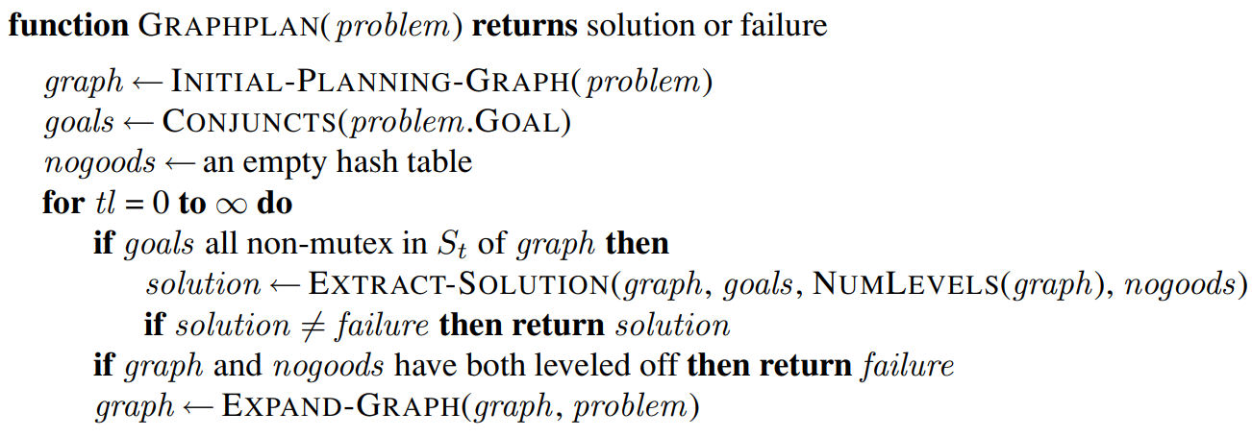
GRAPH PLAN
Notes:
In the context of planning graphs and algorithms like GRAPHPLAN, if the EXTRACT-SOLUTION function fails to find a solution for a specific set of goals at a given level of the planning graph, that particular (level, goals) pair is recorded as a "no-good“
Graph expansion: Add levels until all goals appear without mutex.
Plan extraction: Try to select actions backward that support all goals at each level. If no valid plan is found, the graph is expanded further. This loop continues until either a plan is found or it is proven that no plan exists.

Slide 34
EXTRACT SOLUTION
The plan extraction phase of GRAPHPLAN involves a backward search through the planning graph. It works by:
Selecting actions at level i that support goals at level i+1
Ensuring selected actions are not mutex
Propagating preconditions backward as subgoals for earlier levels.
The algorithm uses memoization (no-goods - a technique that stores the results of expensive function calls, to avoid recomputing failed subgoals) to remember goal sets that have previously failed, improving efficiency by avoiding repeated work.

Slide 35
GRAPH TERMINATion
Leveling off is the point during planning graph construction when:
No new literals (facts) are added to the state level, and
No new mutex relations are discovered between literals or actions.
GRAPHPLAN terminates when:
A valid plan is extracted.
The planning graph levels off and no new information can be added. GRAPHPLAN guarantees that if a plan exists, it will find the shortest one in terms of number of time steps. If no plan exists, it will eventually detect insolvability as at this point, the graph has fully explored all reachable possibilities, and any further expansion would yield no additional benefit.

Slide 36
ADVANTAGES
They are fast to build and polynomial in size
They provide rich information for guiding search
They form the basis for powerful algorithms like GRAPHPLAN and FF by structuring the planning space explicitly, they enable both plan synthesis and heuristic evaluation.

Slide 37
LIMITATIONS
They assume a propositional (non-variable) domain
They do not naturally handle time, uncertainty, or partial observability (actions have fixed outcomes)
Extracting a plan remains computationally hard (PSPACE-complete).
Number of states to reach goal is not known. This is because the plan extraction process requires exploring all possible combinations of actions that could satisfy the goal at each level while ensuring that none of them are mutex.
This backward search through the planning graph is a type of constraint satisfaction problem, and since the number of potential combinations grows exponentially with the number of goals and levels, it falls into the complexity class PSPACE. In the worst case, the planner may need to examine an exponential number of paths to determine whether a valid, non-mutex plan exists. Nevertheless, they are comparatively effective for many classical planning problems.

Slide 38
SUMMARy
Planning graphs provide a structured way to reason about planning problems.
They offer a compact model of state-action evolution, support mutex reasoning, and enable efficient heuristic computation.
Different problems can utilize different heuristics based on their admissibility and suitability to the problem.
Algorithms like GRAPHPLAN leverage these benefits to find optimal plans or prove insolvability.

Slide 39
THANK YOU

